Slide 1
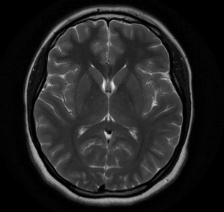
Cognizant NPN Hackathon Team 2
Disease Detection: Tumors
Team:
Amutha Yalini E
Arun VS
Ashfaq Ahamed A
Ashvath Cheppalli
Ashwin ER
Bavashree S
Local mentor: Dr K Sekar
CTS Mentors:
Mr Karthikeyan Ponnusamy
Mr Bharath.

Slide 2
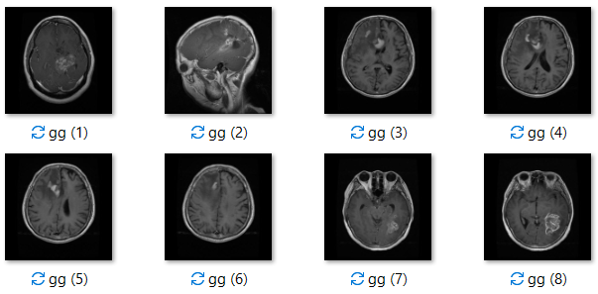
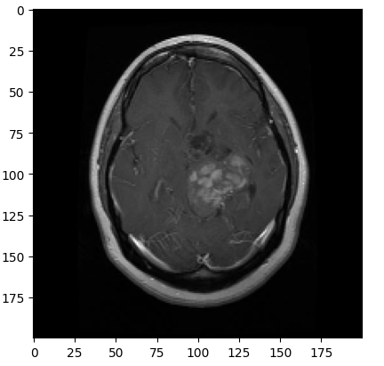
Problem Statement
Early detection and classification of brain tumors is an important research domain in the field of medical imaging and accordingly helps in selecting the most convenient treatment method to save patients life. When benign or malignant tumors grow, they can cause the pressure inside your skull to increase. This can cause brain damage, and it can be life-threatening.

Slide 3
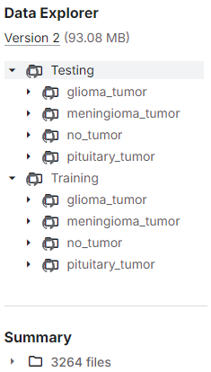
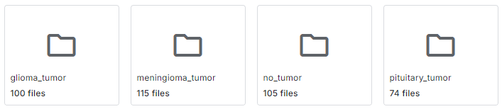
About dataset
Data Overview
Dataset Source: Brain Tumor Classification MRI dataset from Kaggle.
Classes: Glioma, Meningioma, No Tumor, Pituitary Tumor.
Data Preparation:
Images resized to 200x200 pixels.
Grayscale conversion.
Flattened to 1D arrays.
Preprocessing
Data Splitting:
Train/Test split: 80% train, 20% test.
Normalization:
Feature scaling: Dividing pixel values by 255.
PCA Application:
Dimensionality reduction retaining 98% variance.

Slide 4
Metrices Comparison
Comparing Metrices of models analysed
MODELS | Precision | Recall | mAP50
SVM & LR | 0.7752 | 0.7485 | 0.7923
UNet | 0.9345 | 0.9218 | 0.8935
MobileNet v2 | 0.8171 | 0.9782 | 0.7012
YOLOv8n | 0.5884 | 0.9443 | 0.478
YOLOv10 | 0.7677 | 0.3913 | 0.71

Slide 5
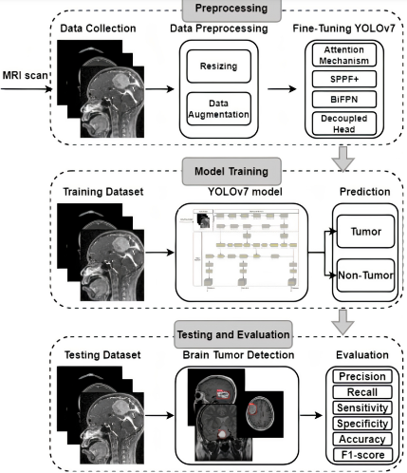
Architecture Diagram
Trained with COCO dataset
Flow:
Dataset uploading
Data Preprocessing
Fine-tuning YOLO v8n
Training model
Validation
Testing model
Evaluation
mAP
Precision
Recall

Slide 6
U-NET
Aims to develop a deep learning model using the U-Net architecture to detect brain tumors from MRI images, providing accurate segmentation and classification for enhanced medical diagnosis.
Model Training:
Training Epochs: 10
Optimizer: Adam
Loss Function: Binary Cross-entropy and categorical cross-entropy is used to optimize segmentation.
Learning Rate: 0.0001

Slide 7



Model Inference
Inference Process
Prediction
Visualization
The trained model (`unet_segmentation.keras and unet_classification.keras) were used to predict tumor locations and types in validation images.
Tumor detection
Confidence
Tumor Type
Detected tumors are visualized with bounding boxes and labeled with tumor type and confidence score.

Slide 8
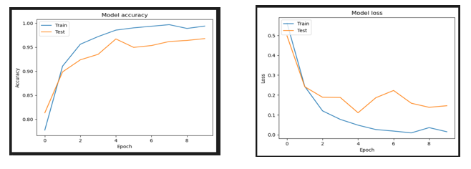
Results & Evaluation
mAP
0.8935
Precision
0.9345
Recall
0.9218

Slide 9
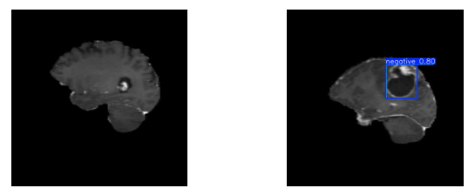
Outputs
Model tends to overfit and does not segment on the tumor location. Results are biased.

Slide 10
MOBILENETV2
The project aims to develop a deep learning model for detecting and classifying brain tumors in MRI images using MobileNET model.
Accurate diagnosis of brain tumors is essential for effective treatment, as it plays a critical role in determining life-saving interventions.
The dataset used is described in custom brain tumor dataset, containing MRI images labeled with various tumor types.
Model Training
MobileNet pre-trained on the dataset.
Training Epochs: 30.
Image Size: 224x224 pixels.
Model developed
The trained model (`mobile.h5`) was used to predict tumor locations and types in validation images.
Yolov10

Slide 11
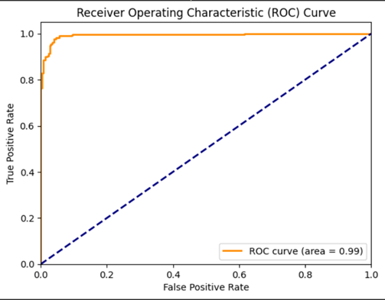
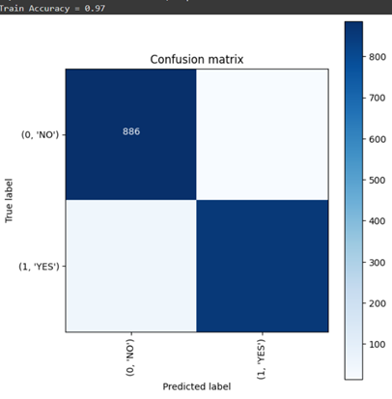
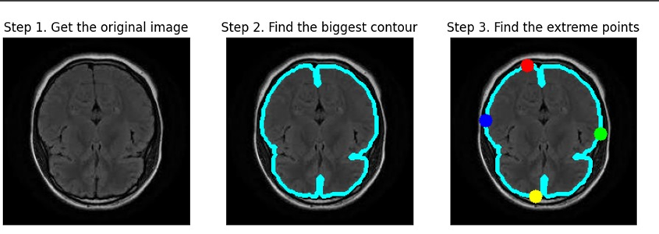
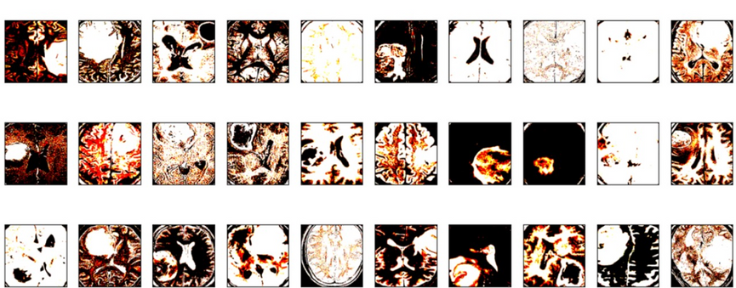
Results
& Evaluation
Yolov10

Slide 12
YOLOv10
YOLOv10 would aim to make object detection faster, more accurate, and more efficient. It would try to detect objects in images with better precision while using less computing power, making it suitable for use in real-time applications and on devices with limited resources.
Model Training:
Training Epochs: 30
Optimizer: AdamW
Confidence level: 0.25

Slide 13
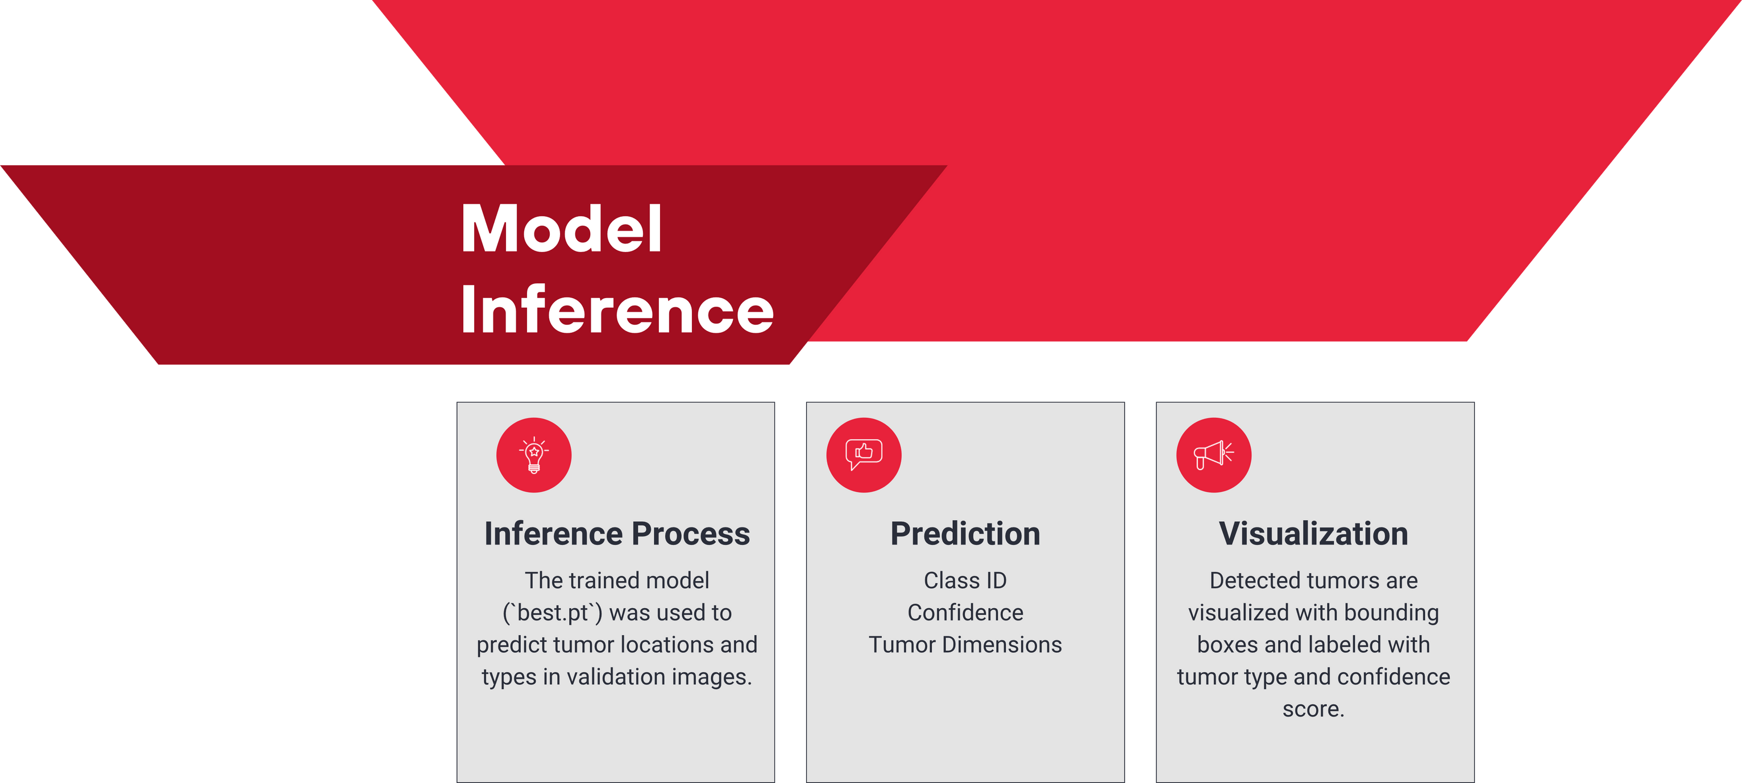

Slide 14
Classification using SVM and Logistic Regression
Support Vector Machine (SVM):
Definition: SVM is a supervised learning algorithm used for classification and regression tasks. It works by finding the hyperplane that best separates the classes in the feature space.
Key Features:
Versatility: SVM is effective in high-dimensional spaces and is often used in scenarios with many features.
Performance: SVM performs well with limited data, especially when there's a clear margin of separation between classes.
Logistic Regression:
Definition: Logistic Regression is a statistical model that is primarily used for binary classification tasks. It models the probability of a binary outcome based on one or more predictor variables.
Key Features:
Simplicity: Logistic Regression is easy to implement and interpret, making it ideal for both binary and multiclass classification tasks.
Probabilistic Interpretation: The output of Logistic Regression can be interpreted as the probability of a certain class.
Objective: To classify brain tumors into four categories using machine learning models.
Tumor Classes:
Glioma Tumor
Meningioma Tumor
No Tumor
Pituitary Tumor
Approach: Utilize SVM and Logistic Regression with PCA for dimensionality reduction.

Slide 15
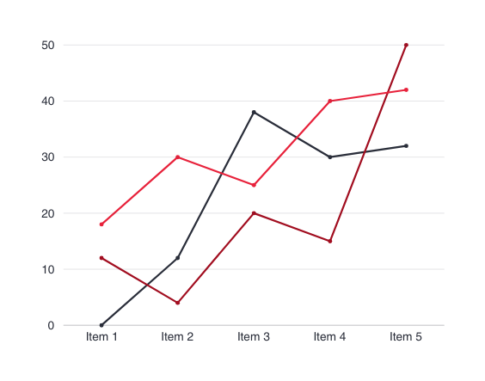
Metrics
SVM
Logistic Regression
Mean Average Precision: 0.7752727847507274
Recall: 0.7485769264876706
MAP: 0.792381680933852
Mean Average Precision: 0.7791010806490843
Logistic Regression Recall: 0.7507633131222178
Logistic Regression MAP: 0.7755651505625953

Slide 16
Features
lg = LogisticRegression(C=0.1) lg.fit(pca_train, ytrain). The default penalty in LogisticRegression is L2 regularization. L2 regularization penalizes large coefficients by adding a term to the loss function that is proportional to the sum of the squared coefficients. Logistic Regression with L2 regularization assigns weights to features and includes a penalty proportional to the square of the weights to prevent overfitting, which helps the model generalize better and perform well on unseen data by discouraging excessively large coefficients. | SVC() Probability Estimates: Not included in the base SVM model (only used in the first version with probability=True). Kernel: Default is a radial basis function (RBF) kernel. Hyperparameters: C: Regularization parameter. Default is 1.0.

Slide 17
Dimensionality Reduction: PCA transforms high-dimensional data into a lower-dimensional space, retaining 98% of the variance (`PCA(0.98)`).
Application: Both SVM and Logistic Regression are trained and tested on the PCA-transformed data (`pca_train` and `pca_test`).
Benefits:
Simplifies the dataset, reducing computational complexity.
Helps prevent overfitting by focusing on the most significant features.
Improves model efficiency and generalization.
SVM:
sv.fit(pca_train, ytrain)
Logistic Regression:
lg.fit(pca_train, ytrain)
PCA in SVM and Logistic Regression

Slide 18
Challenges
Dataset: Brain Tumor MRI from Kaggle (Training: 3,264 Files, Testing: 394 Files)
# Preprocessing
img_flattened = cv2.resize(cv2.imread(image_path, cv2.IMREAD_GRAYSCALE), (200, 200)).flatten()
# Classification
svm = SVC(kernel='linear').fit(X_train, y_train)
y_pred_svm = svm.predict(X_test)
log_reg = LogisticRegression().fit(X_train, y_train)
y_pred_log_reg = log_reg.predict(X_test)
Disadvantages:
No Detection Capability: Only classifies, cannot localize tumors.
Scalability Issues: Requires extensive preprocessing and is less efficient with larger datasets.
# Model Initialization and Training
model = YOLOv5('yolov5s.pt', device='cuda')
model.train(data='yolo_data.yaml', epochs=100, batch_size=16)
# Prediction
results = model.predict('test_image.jpg')
Advantages:
Integrated Detection & Classification: Simultaneously detects and classifies tumors in real-time.
Scalable and Efficient: Handles large datasets with minimal preprocessing, optimized for performance.

Slide 19
Brain Tumor QueryBot
A chatbot that offers preliminary guidance and insights into terms related to brain tumor.
Provides prognosis and statistics.
Clears misconceptions of being affected by tumors.

Slide 20
Overview
Backend Setup:
Framework: Built using Flask, a web framework for Python.
Model: Utilizes GPT-2 from the Hugging Face Transformers library.
Key Features:
Flask Application:
Homepage (/): Displays the main interface.
Response Endpoint (/get_response): Processes user queries and returns answers.
Model Loading:
Tokenizer & Model: Converts text to tokens for GPT-2 and generates responses.
Padding Token: Ensures uniform sequence lengths.

Slide 21

Workflow
Response Generation:
Tokenization: Converts user input into model-readable tokens.
Text Generation: GPT-2 generates a response with settings like:
max_length (200 tokens)
temperature (0.7 for randomness)
top_k and top_p (sampling strategies)
no_repeat_ngram_size (prevents repetition)
Processing:
Avoids Repetition: Removes repeated questions from responses.
Proper Ending: Ensures responses end with punctuation.
Workflow:
Request: User submits a query via the frontend.
Processing: Query is tokenized, and GPT-2 generates a response.
Delivery: Cleaned response is sent back to the frontend in JSON format.

Slide 22
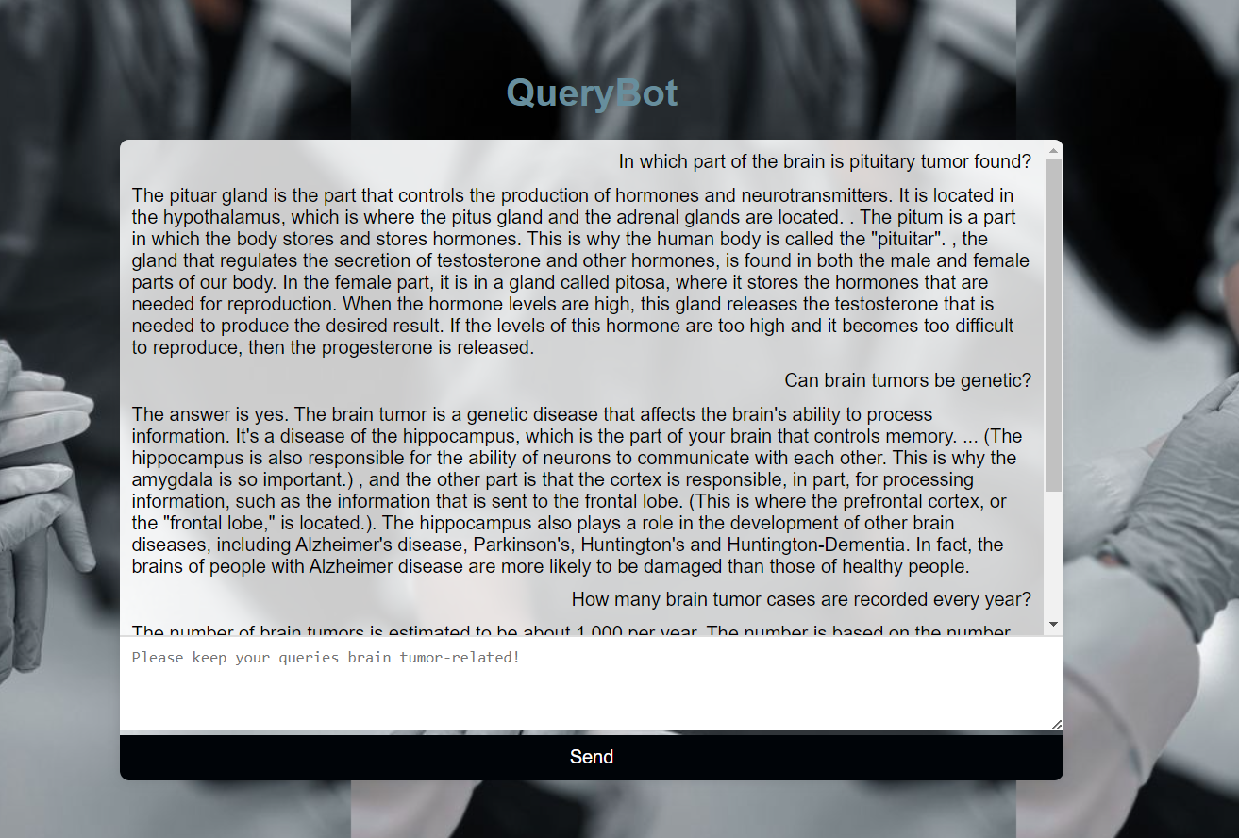
Result
and
Evaluation
Response Accuracy: 85%
Response Quality: 8.1/10
Response Time: 434 milliseconds
Repetition Handling: 90%

Slide 23
YOLOv8n
The project aims to develop a deep learning model for detecting and classifying brain tumors in MRI images.Utilizes the YOLOv8n model, a cutting-edge object detection architecture.Brain tumors are life-threatening and require accurate diagnosis for effective treatment.
Model Training:
Training Epochs: 100
Optimizer: Adam
Loss Function: Binary Cross-entropy &
Categorical cross-entropy
Learning Rate: 0.0001

Slide 25
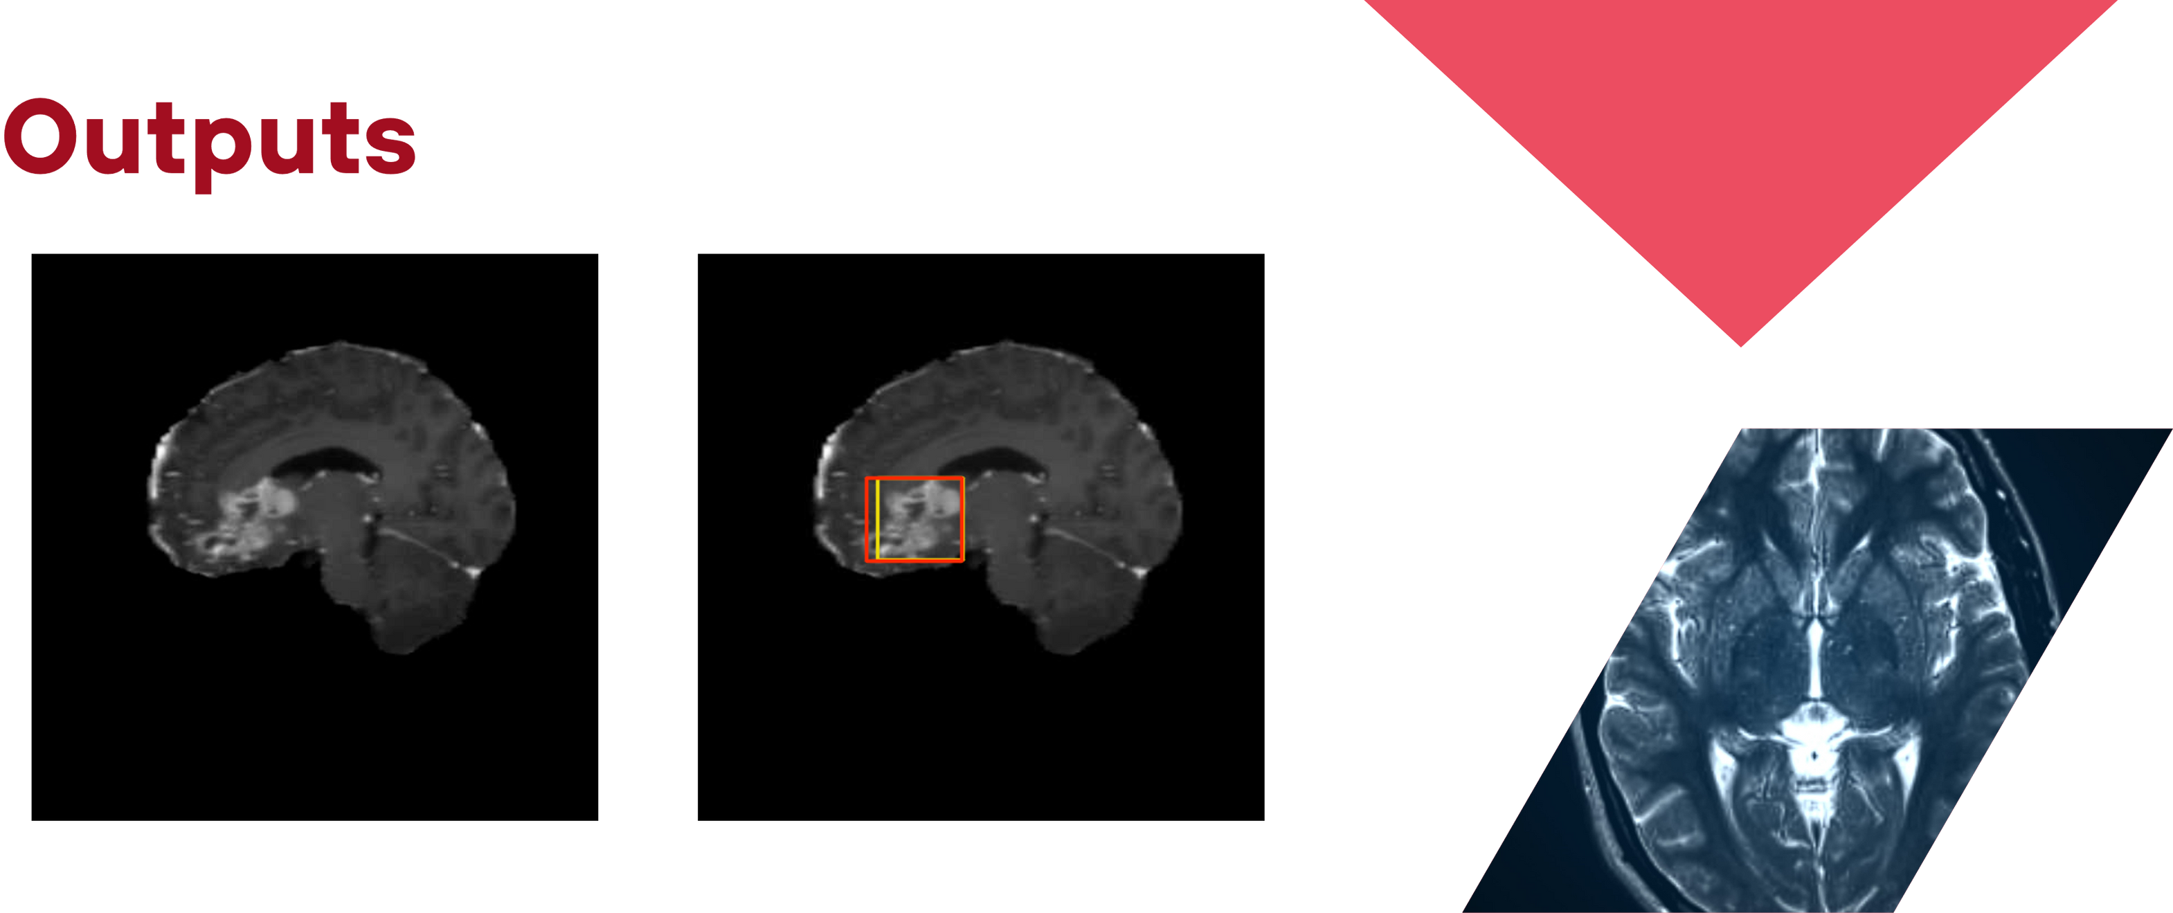

Slide 26
Advantages & Limitations
Early Detection
High Accuracy
Model Dependency
Limited Scope
Facilitates timely intervention, crucial for saving lives.
Uses YOLOv8n and advanced AI, enhancing detection precision
Accuracy depends on the quality of the trained dataset.
Focuses on specific tumor types; may not detect all variants.

Slide 27
Thank you.

